Slide 1
Control Statements: Part I
Java™ How to Program, 9/e

Slide 2
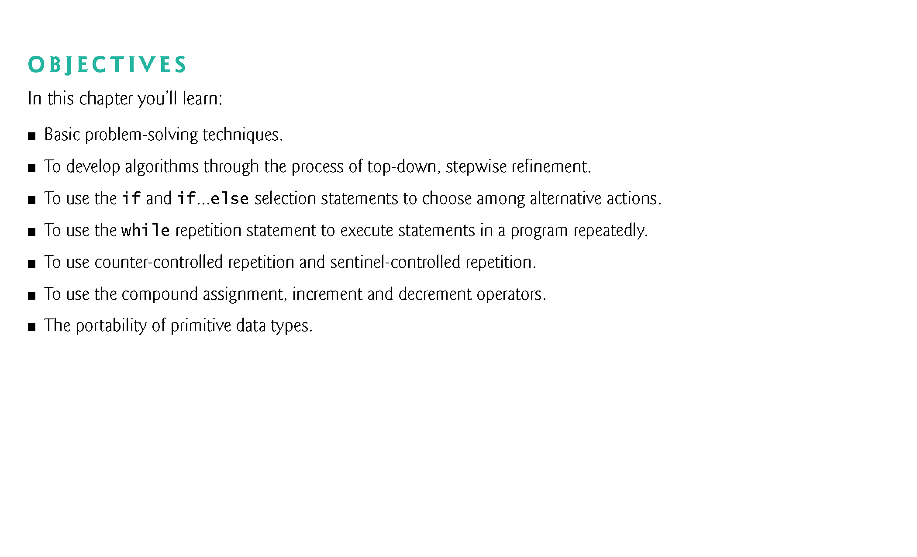

Slide 3
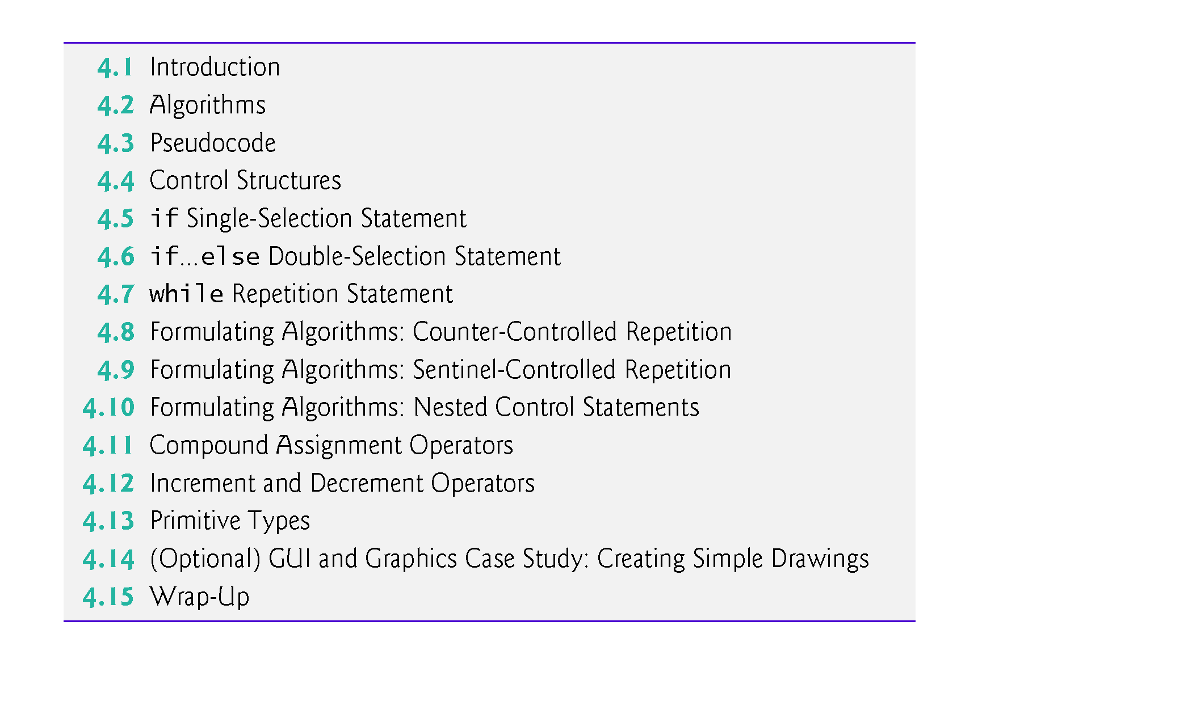

Slide 4
4.1 Introduction
Before writing a program to solve a problem, have a thorough understanding of the problem and a carefully planned approach to solving it.
Understand the types of building blocks that are available and employ proven program-construction techniques.
This chapter introduces
The if, if…else and while statements
Compound assignment, increment and decrement operators
Portability of Java’s primitive types

Slide 5
4.2 Algorithms
Any computing problem can be solved by executing a series of actions in a specific order.
An algorithm is a procedure for solving a problem in terms of
the actions to execute and
the order in which these actions execute
The “rise-and-shine algorithm” followed by one executive for getting out of bed and going to work:
(1) Get out of bed; (2) take off pajamas; (3) take a shower; (4) get dressed; (5) eat breakfast; (6) carpool to work.
Suppose that the same steps are performed in a slightly different order:
(1) Get out of bed; (2) take off pajamas; (3) get dressed; (4) take a shower; (5) eat breakfast; (6) carpool to work.
Specifying the order in which statements (actions) execute in a program is called program control.

Slide 6
4.3 Pseudocode
Pseudocode is an informal language that helps you develop algorithms without having to worry about the strict details of Java language syntax.
Particularly useful for developing algorithms that will be converted to structured portions of Java programs.
Similar to everyday English.
Helps you “think out” a program before attempting to write it in a programming language, such as Java.
You can type pseudocode conveniently, using any text-editor program.
Carefully prepared pseudocode can easily be converted to a corresponding Java program.
Pseudocode normally describes only statements representing the actions that occur after you convert a program from pseudocode to Java and the program is run on a computer.
e.g., input, output or calculations.

Slide 7
4.4 Control Structures
Sequential execution: Statements in a program execute one after the other in the order in which they are written.
Transfer of control: Various Java statements, enable you to specify that the next statement to execute is not necessarily the next one in sequence.
Bohm and Jacopini
Demonstrated that programs could be written without any goto statements.
All programs can be written in terms of only three control structures—the sequence structure, the selection structure and the repetition structure.
When we introduce Java’s control structure implementations, we’ll refer to them in the terminology of the Java Language Specification as “control statements.”

Slide 8
4.4 Control Structures (Cont.)
Sequence structure
Built into Java.
Unless directed otherwise, the computer executes Java statements one after the other in the order in which they’re written.
The activity diagram in Fig. 4.1 illustrates a typical sequence structure in which two calculations are performed in order.
Java lets you have as many actions as you want in a sequence structure.
Anywhere a single action may be placed, we may place several actions in sequence.

Slide 9
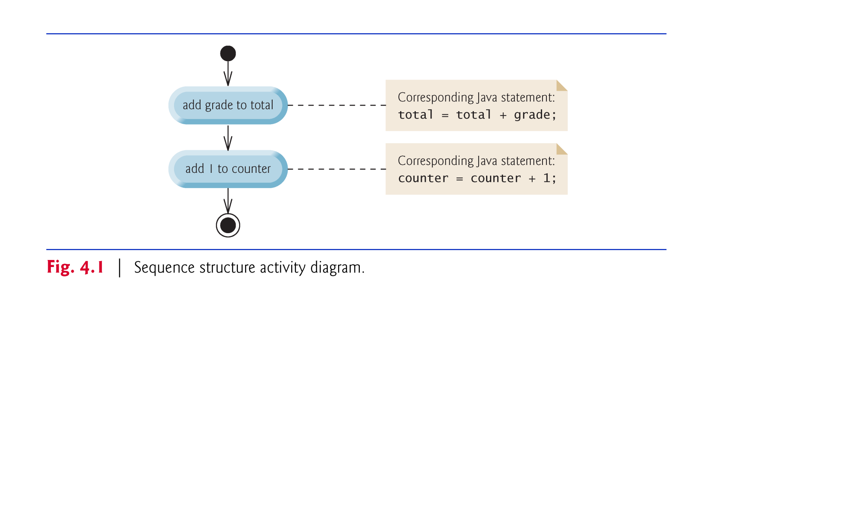

Slide 10
4.4 Control Structures (Cont.)
Sequence structure activity diagram in Fig. 4.1.
Two action states that represent actions to perform.
Each contains an action expression that specifies a particular action to perform.
Arrows represent transitions (order in which the actions represented by the action states occur).
Solid circle at the top represents the initial state—the beginning of the workflow before the program performs the modeled actions.
Solid circle surrounded by a hollow circle at the bottom represents the final state—the end of the workflow after the program performs its actions.

Slide 11
4.4 Control Structures (Cont.)
Three types of selection statements.
if statement:
Performs an action, if a condition is true; skips it, if false.
Single-selection statement—selects or ignores a single action (or group of actions).
if…else statement:
Performs an action if a condition is true and performs a different action if the condition is false.
Double-selection statement—selects between two different actions (or groups of actions).
switch statement
Performs one of several actions, based on the value of an expression.
Multiple-selection statement—selects among many different actions (or groups of actions).

Slide 12
4.4 Control Structures (Cont.)
Three repetition statements (also called looping statements)
Perform statements repeatedly while a loop-continuation condition remains true.
while and for statements perform the action(s) in their bodies zero or more times
if the loop-continuation condition is initially false, the body will not execute.
The do…while statement performs the action(s) in its body one or more times.
if, else, switch, while, do and for are keywords.
Appendix C: Complete list of Java keywords.

Slide 13
4.4 Control Structures (Cont.)
Every program is formed by combining the sequence statement, selection statements (three types) and repetition statements (three types) as appropriate for the algorithm the program implements.
Can model each control statement as an activity diagram.
Initial state and a final state represent a control statement’s entry point and exit point, respectively.
Single-entry/single-exit control statements
Control-statement stacking—connect the exit point of one to the entry point of the next.
Control-statement nesting—a control statement inside another.

Slide 14
4.5 if Single-Selection Statement
Pseudocode
If student’s grade is greater than or equal to 60 Print “Passed”
If the condition is false, the Print statement is ignored, and the next pseudocode statement in order is performed.
Indentation
Optional, but recommended
Emphasizes the inherent structure of structured programs
The preceding pseudocode If in Java:
if ( studentGrade >= 60 ) System.out.println( "Passed" );
Corresponds closely to the pseudocode.

Slide 15
4.5 if Single-Selection Statement (Cont.)
Figure 4.2 if statement UML activity diagram.
Diamond, or decision symbol, indicates that a decision is to be made.
Workflow continues along a path determined by the symbol’s guard conditions, which can be true or false.
Each transition arrow emerging from a decision symbol has a guard condition (in square brackets next to the arrow).
If a guard condition is true, the workflow enters the action state to which the transition arrow points.

Slide 16
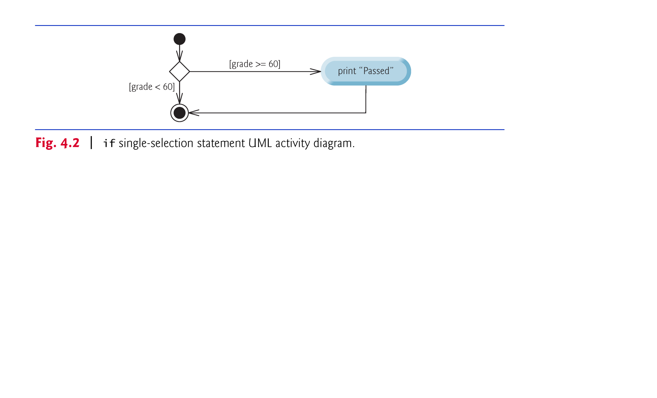

Slide 17
4.6 if…else Double-Selection Statement
if…else double-selection statement—specify an action to perform when the condition is true and a different action when the condition is false.
Pseudocode
If student’s grade is greater than or equal to 60 Print “Passed” Else Print “Failed”
The preceding If…Else pseudocode statement in Java:
if ( grade >= 60 ) System.out.println( "Passed" ); else System.out.println( "Failed" );
Note that the body of the else is also indented.

Slide 18
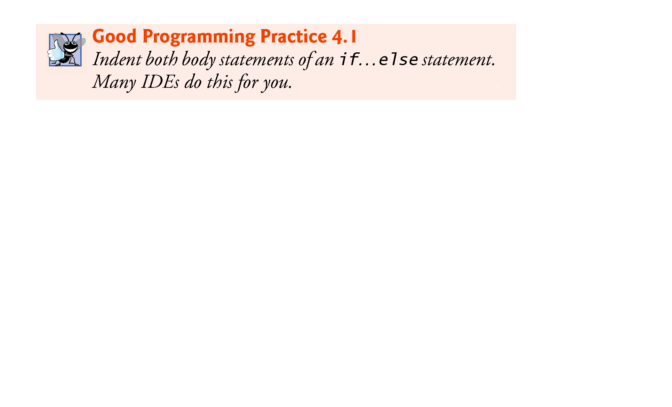

Slide 19
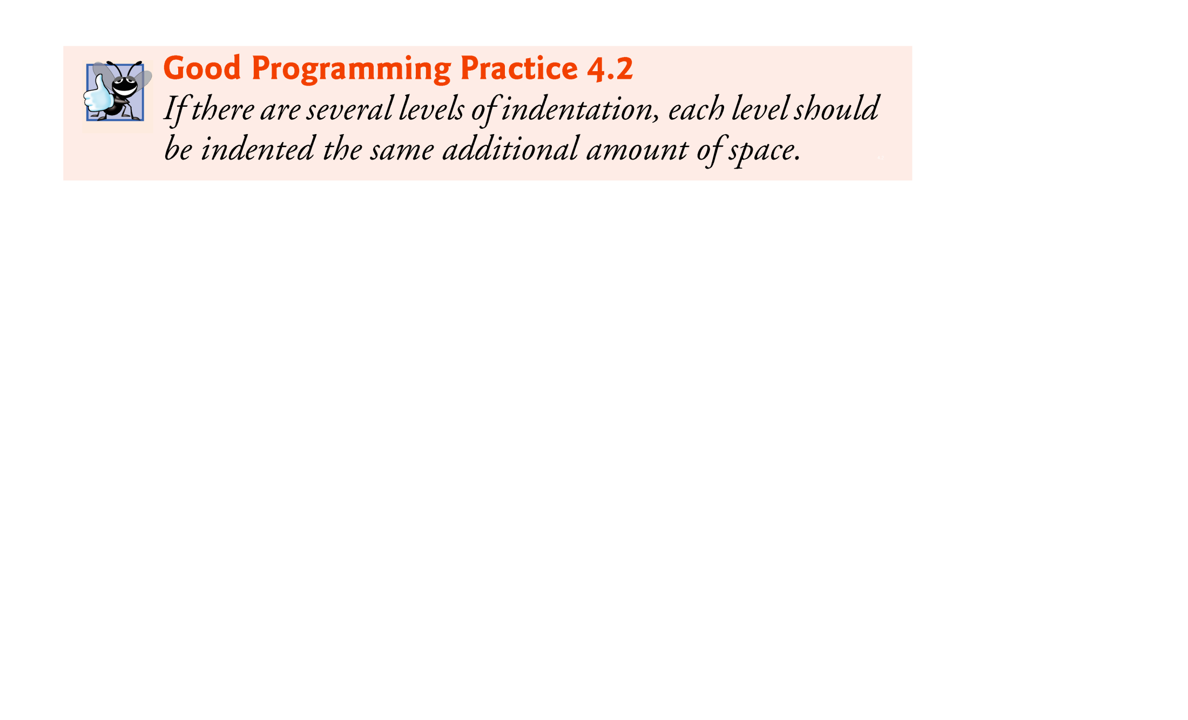

Slide 20
4.6 if…else Double-Selection Statement (Cont.)
Figure 4.3 illustrates the flow of control in the if…else statement.
The symbols in the UML activity diagram (besides the initial state, transition arrows and final state) represent action states and decisions.

Slide 21
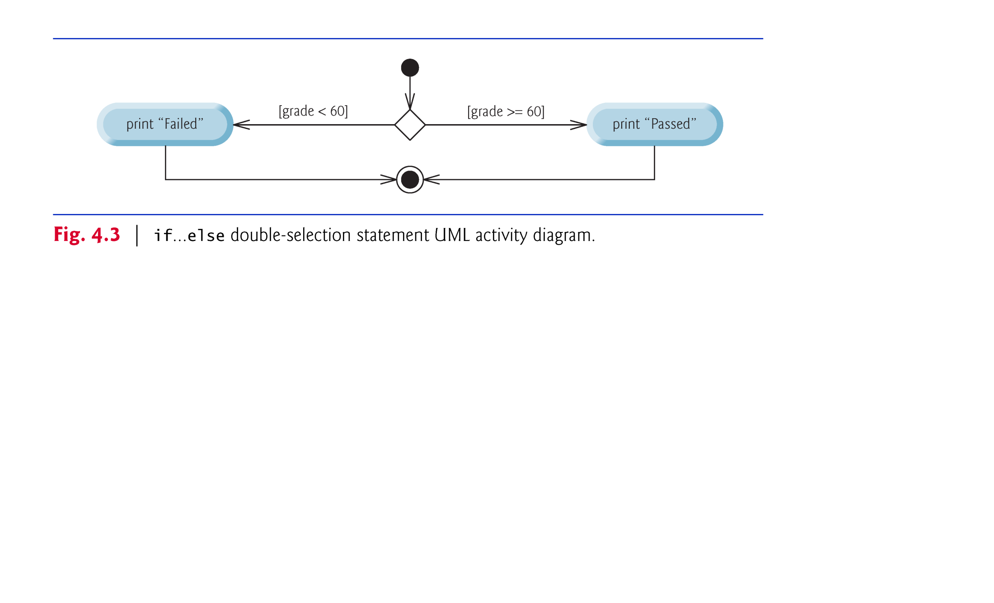

Slide 22
4.6 if…else Double-Selection Statement (Cont.)
Conditional operator (?:)—shorthand if…else.
Ternary operator (takes three operands)
Operands and ?: form a conditional expression
Operand to the left of the ? is a boolean expression—evaluates to a boolean value (true or false)
Second operand (between the ? and :) is the value if the boolean expression is true
Third operand (to the right of the :) is the value if the boolean expression evaluates to false.

Slide 23
4.6 if…else Double-Selection Statement (Cont.)
Example:
System.out.println( studentGrade >= 60 ? "Passed" : "Failed" );
Evaluates to the string "Passed" if the boolean expression studentGrade >= 60 is true and to the string "Failed" if it is false.

Slide 24
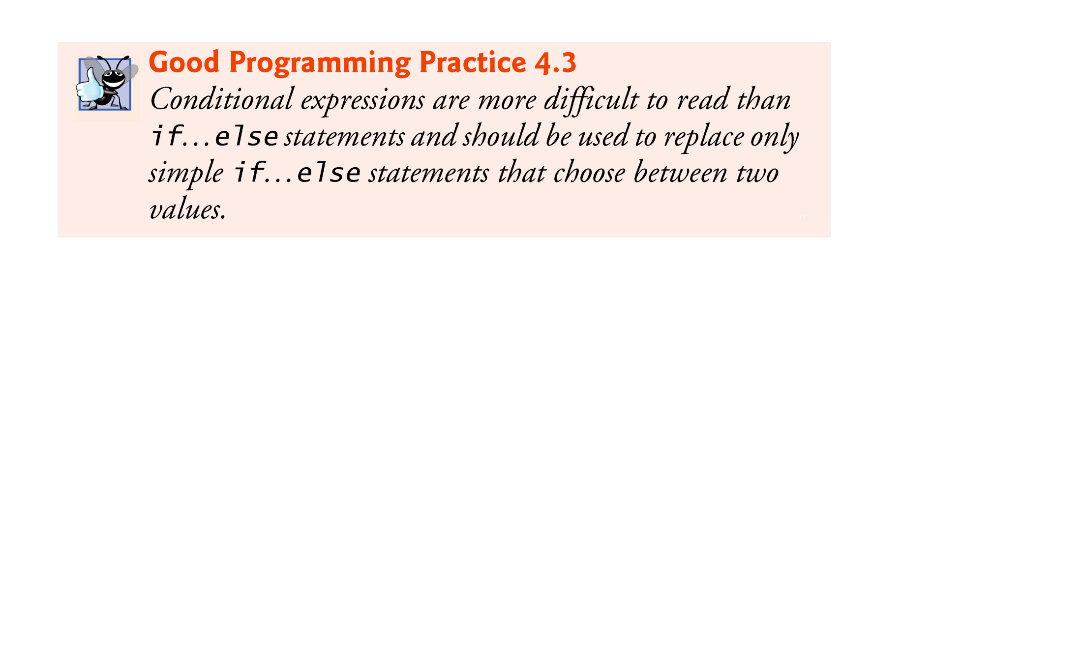

Slide 25
4.6 if…else Double-Selection Statement (Cont.)
Can test multiple cases by placing if…else statements inside other if…else statements to create nested if…else statements.
Pseudocode:
If student’s grade is greater than or equal to 90 Print “A” else If student’s grade is greater than or equal to 80 Print “B” else If student’s grade is greater than or equal to 70 Print “C” else If student’s grade is greater than or equal to 60 Print “D” else Print “F”

Slide 26
4.6 if…else Double-Selection Statement (Cont.)
This pseudocode may be written in Java as
if ( studentGrade >= 90 ) System.out.println( "A" ); else if ( studentGrade >= 80 ) System.out.println( "B" ); else if ( studentGrade >= 70 ) System.out.println( "C" ); else if ( studentGrade >= 60 ) System.out.println( "D" ); else System.out.println( "F" );
If studentGrade >= 90, the first four conditions will be true, but only the statement in the if part of the first if…else statement will execute. After that, the else part of the “outermost” if…else statement is skipped.

Slide 27
4.6 if…else Double-Selection Statement (Cont.)
Most Java programmers prefer to write the preceding nested if…else statement as
if ( studentGrade >= 90 ) System.out.println( "A" ); else if ( studentGrade >= 80 ) System.out.println( "B" ); else if ( studentGrade >= 70 ) System.out.println( "C" ); else if ( studentGrade >= 60 ) System.out.println( "D" ); else System.out.println( "F" );
The two forms are identical except for the spacing and indentation, which the compiler ignores.

Slide 28
4.6 if…else Double-Selection Statement (Cont.)
The Java compiler always associates an else with the immediately preceding if unless told to do otherwise by the placement of braces ({ and }).
Referred to as the dangling-else problem.
The following code is not what it appears:
if ( x > 5 ) if ( y > 5 ) System.out.println( "x and y are > 5" ); else System.out.println( "x is <= 5" );
Beware! This nested if…else statement does not execute as it appears. The compiler actually interprets the statement as
if ( x > 5 ) if ( y > 5 ) System.out.println( "x and y are > 5" ); else System.out.println( "x is <= 5" );

Slide 29
4.6 if…else Double-Selection Statement (Cont.)
To force the nested if…else statement to execute as it was originally intended, we must write it as follows:
if ( x > 5 ) { if ( y > 5 ) System.out.println( "x and y are > 5" ); } else System.out.println( "x is <= 5" );
The braces indicate that the second if is in the body of the first and that the else is associated with the first if.
Exercises 4.27–4.28 investigate the dangling-else problem further.

Slide 30
4.6 if…else Double-Selection Statement (Cont.)
The if statement normally expects only one statement in its body.
To include several statements in the body of an if (or the body of an else for an if…else statement), enclose the statements in braces.
Statements contained in a pair of braces form a block.
A block can be placed anywhere that a single statement can be placed.
Example: A block in the else part of an if…else statement:
if ( grade >= 60 ) System.out.println("Passed"); else { System.out.println("Failed"); System.out.println("You must take this course again."); }

Slide 31
4.6 if…else Double-Selection Statement (Cont.)
Syntax errors (e.g., when one brace in a block is left out of the program) are caught by the compiler.
A logic error (e.g., when both braces in a block are left out of the program) has its effect at execution time.
A fatal logic error causes a program to fail and terminate prematurely.
A nonfatal logic error allows a program to continue executing but causes it to produce incorrect results.

Slide 32
4.6 if…else Double-Selection Statement (Cont.)
Just as a block can be placed anywhere a single statement can be placed, it’s also possible to have an empty statement.
The empty statement is represented by placing a semicolon (;) where a statement would normally be.

Slide 33
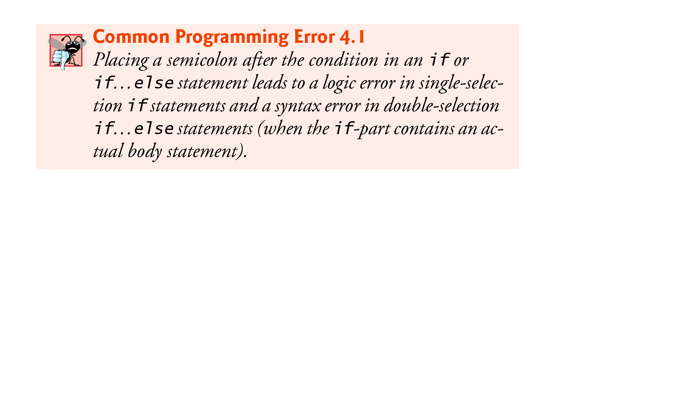

Slide 34
4.7 while Repetition Statement
Repetition statement—repeats an action while a condition remains true.
Pseudocode
While there are more items on my shopping list Purchase next item and cross it off my list
The repetition statement’s body may be a single statement or a block.
Eventually, the condition will become false. At this point, the repetition terminates, and the first statement after the repetition statement executes.

Slide 35
4.7 while Repetition Statement (Cont.)
Example of Java’s while repetition statement: find the first power of 3 larger than 100. Assume int variable product is initialized to 3.
while ( product <= 100 ) product = 3 * product;
Each iteration multiplies product by 3, so product takes on the values 9, 27, 81 and 243 successively.
When variable product becomes 243, the while-statement condition—product <= 100—becomes false.
Repetition terminates. The final value of product is 243.
Program execution continues with the next statement after the while statement.

Slide 36
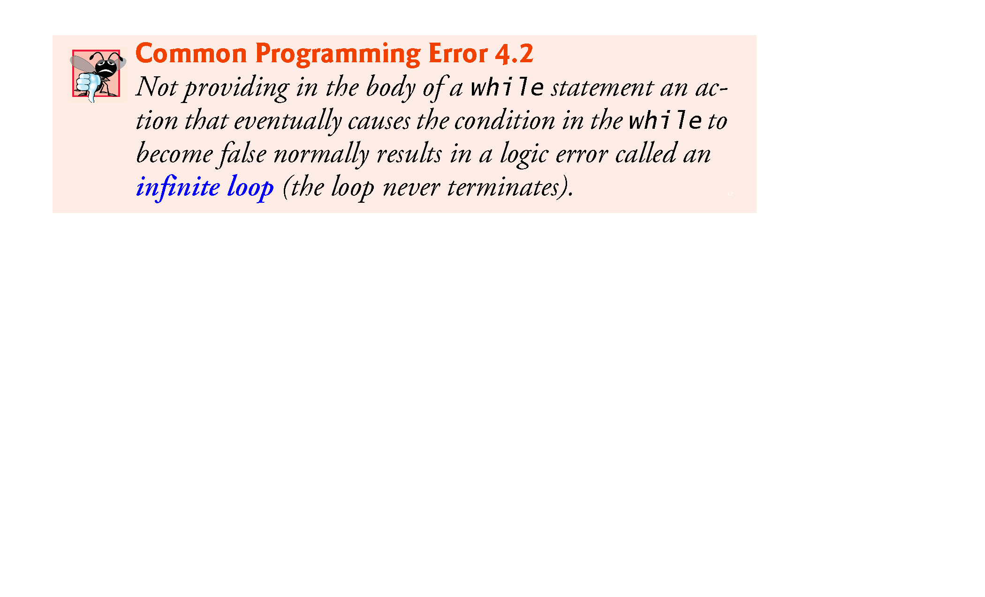

Slide 37
4.7 while Repetition Statement (Cont.)
The UML activity diagram in Fig. 4.4 illustrates the flow of control in the preceding while statement.
The UML represents both the merge symbol and the decision symbol as diamonds.
The merge symbol joins two flows of activity into one.

Slide 38
4.7 while Repetition Statement (Cont.)
The decision and merge symbols can be distinguished by the number of “incoming” and “outgoing” transition arrows.
A decision symbol has one transition arrow pointing to the diamond and two or more pointing out from it to indicate possible transitions from that point. Each transition arrow pointing out of a decision symbol has a guard condition next to it.
A merge symbol has two or more transition arrows pointing to the diamond and only one pointing from the diamond, to indicate multiple activity flows merging to continue the activity. None of the transition arrows associated with a merge symbol has a guard condition.

Slide 39
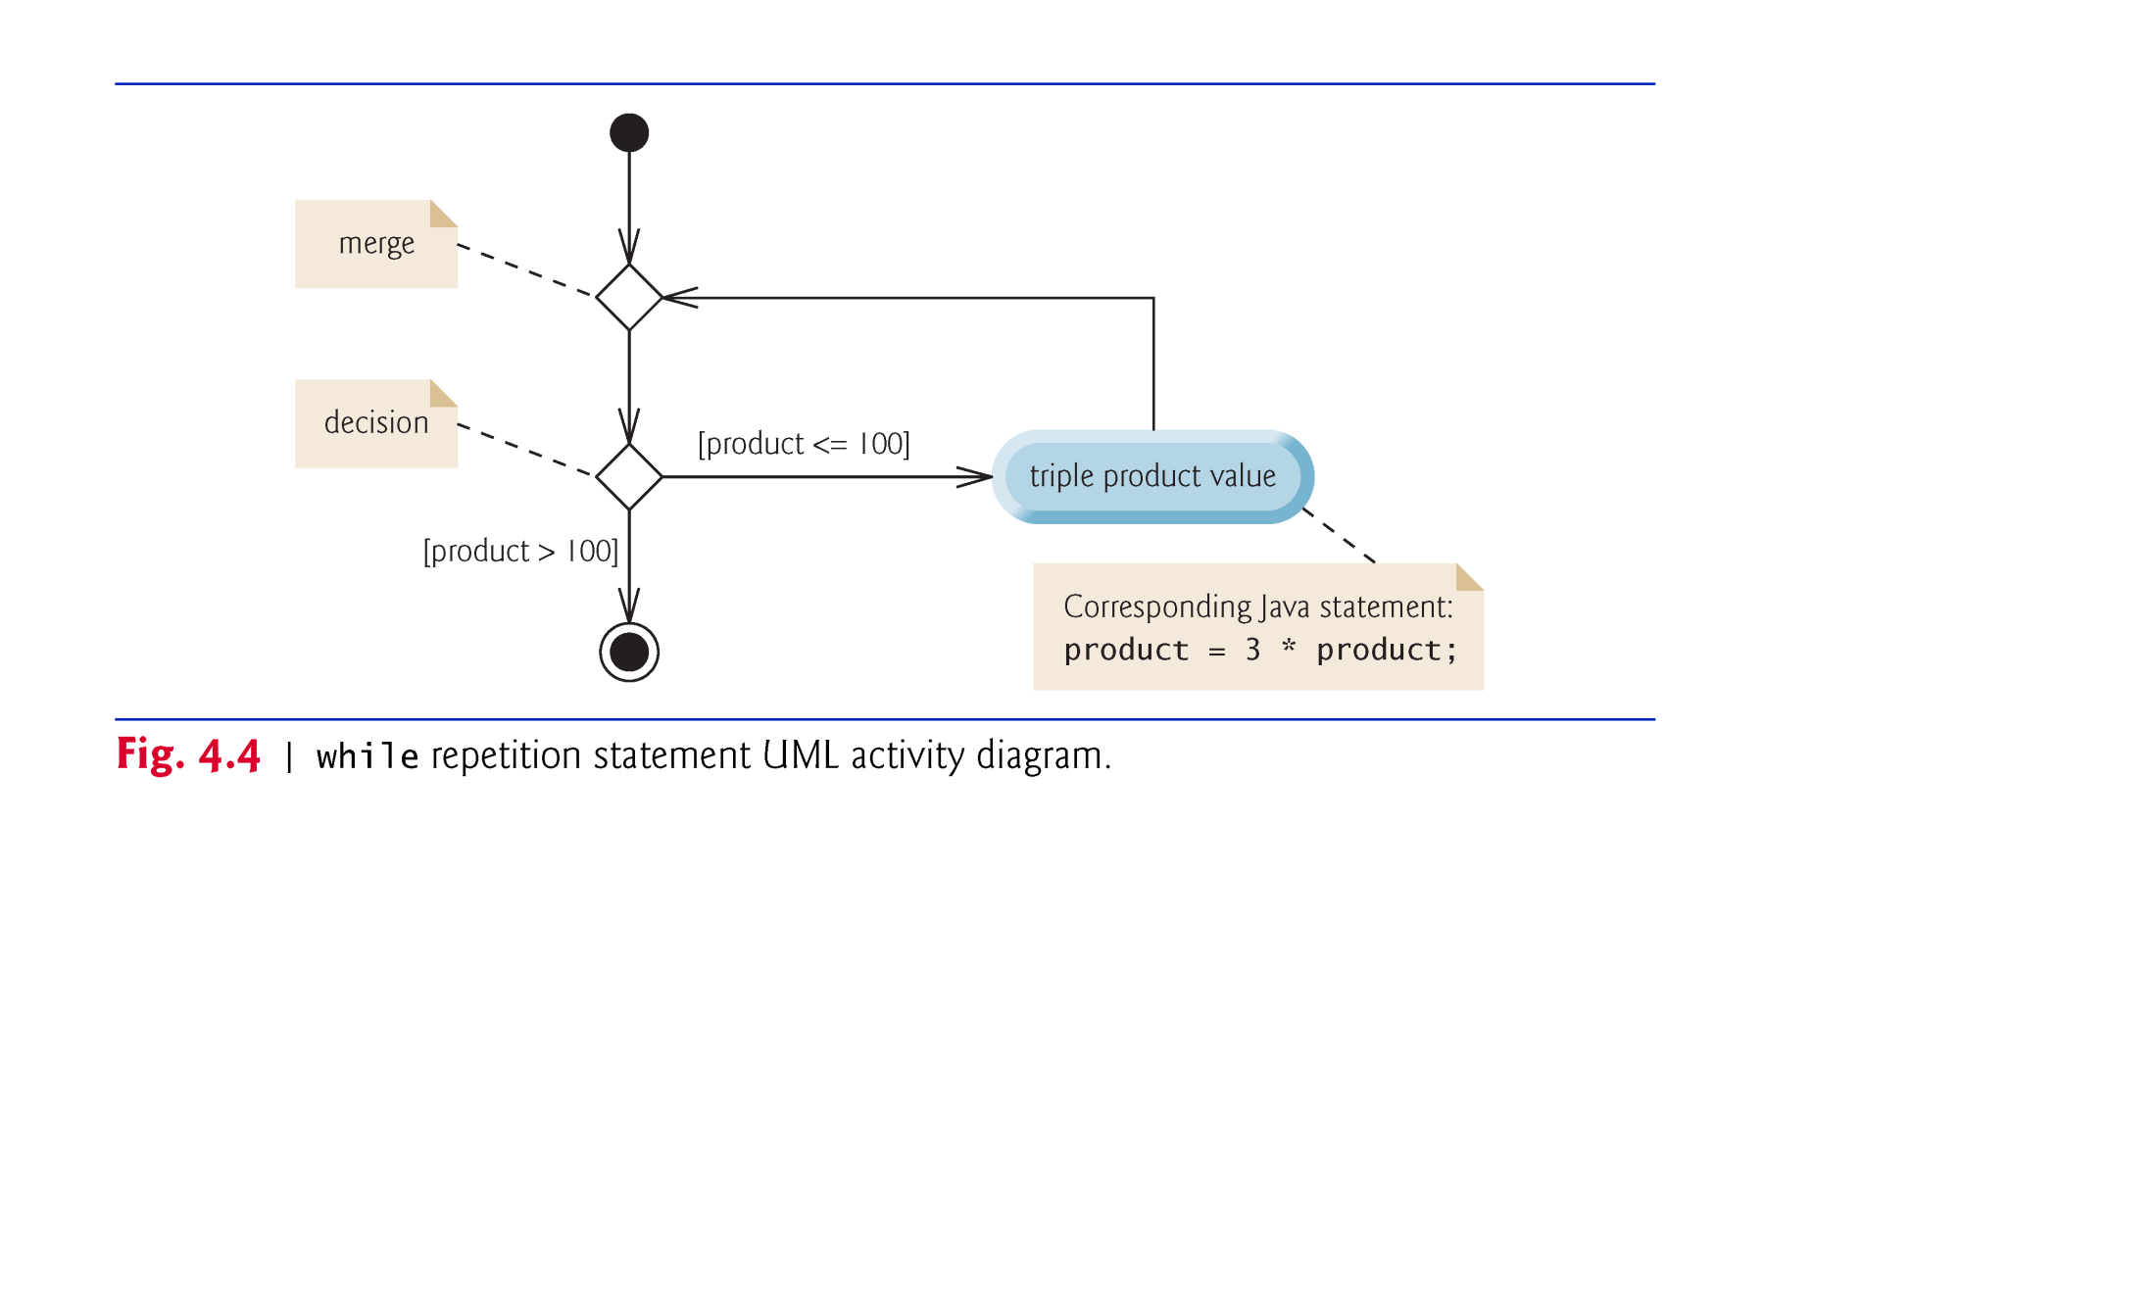

Slide 40
4.8 Formulating Algorithms: Counter-Controlled Repetition
A class of ten students took a quiz. The grades (integers in the range 0 to 100) for this quiz are available to you. Determine the class average on the quiz.
The class average is equal to the sum of the grades divided by the number of students.
The algorithm for solving this problem on a computer must input each grade, keep track of the total of all grades input, perform the averaging calculation and print the result.
Use counter-controlled repetition to input the grades one at a time.
A variable called a counter (or control variable) controls the number of times a set of statements will execute.
Counter-controlled repetition is often called definite repetition, because the number of repetitions is known before the loop begins executing.

Slide 41
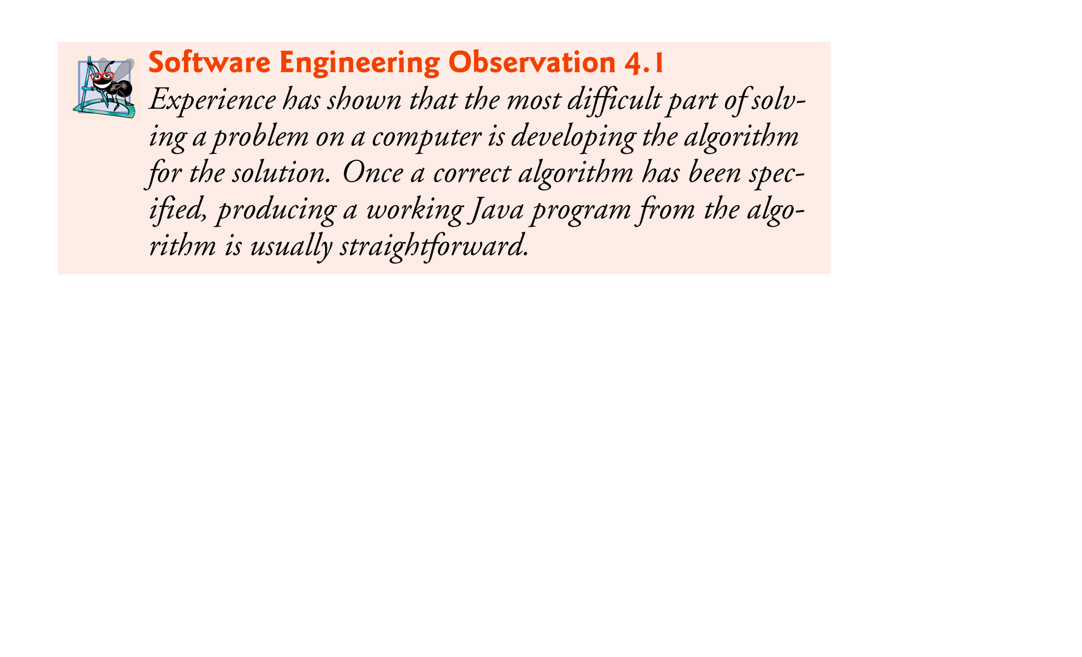

Slide 42
4.11 Compound Assignment Operators
Compound assignment operators abbreviate assignment expressions.
Statements like variable = variable operator expression; where operator is one of the binary operators +, -, *, / or % can be written in the form
variable operator= expression;
Example:
c = c + 3;
can be written with the addition compound assignment operator, +=, as
c += 3;
The += operator adds the value of the expression on its right to the value of the variable on its left and stores the result in the variable on the left of the operator.

Slide 43
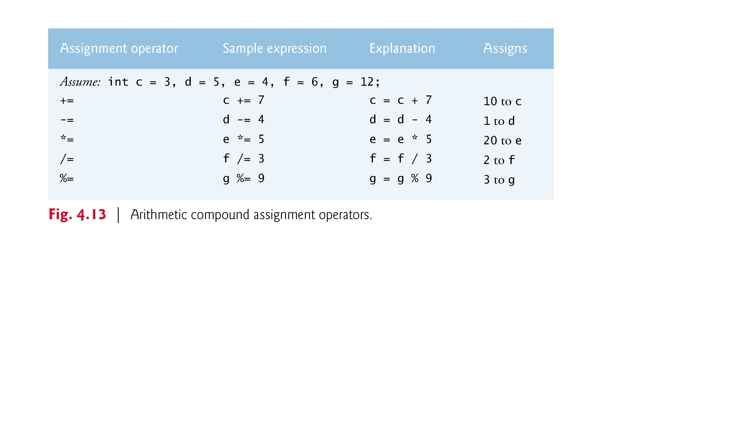

Slide 44
4.12 Increment and Decrement Operators
Unary increment operator, ++, adds one to its operand
Unary decrement operator, --, subtracts one from its operand
An increment or decrement operator that is prefixed to (placed before) a variable is referred to as the prefix increment or prefix decrement operator, respectively.
An increment or decrement operator that is postfixed to (placed after) a variable is referred to as the postfix increment or postfix decrement operator, respectively.

Slide 45
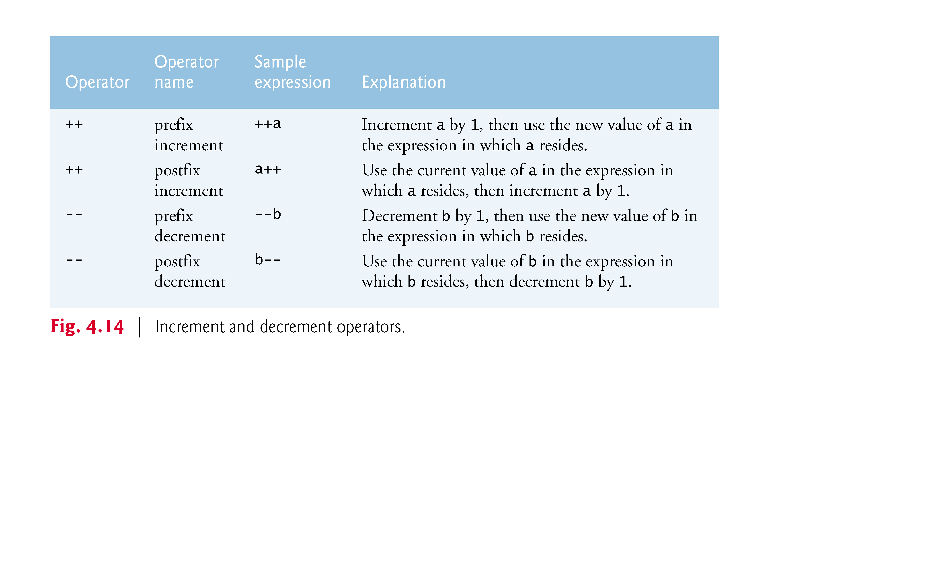

Slide 46
4.12 Increment and Decrement Operators (Cont.)
Using the prefix increment (or decrement) operator to add (or subtract) 1 from a variable is known as preincrementing (or predecrementing) the variable.
Preincrementing (or predecrementing) a variable causes the variable to be incremented (decremented) by 1; then the new value is used in the expression in which it appears.
Using the postfix increment (or decrement) operator to add (or subtract) 1 from a variable is known as postincrementing (or postdecrementing) the variable.
This causes the current value of the variable to be used in the expression in which it appears; then the variable’s value is incremented (decremented) by 1.

Slide 47
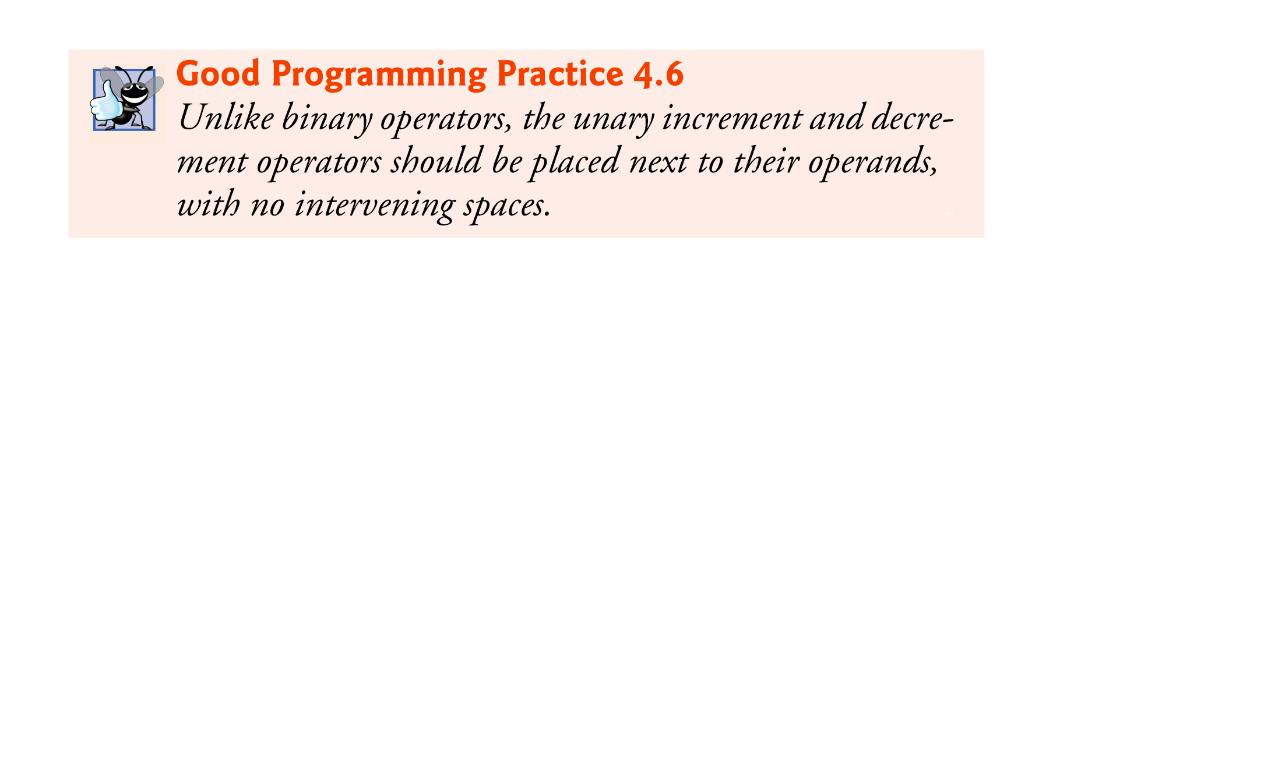

Slide 48
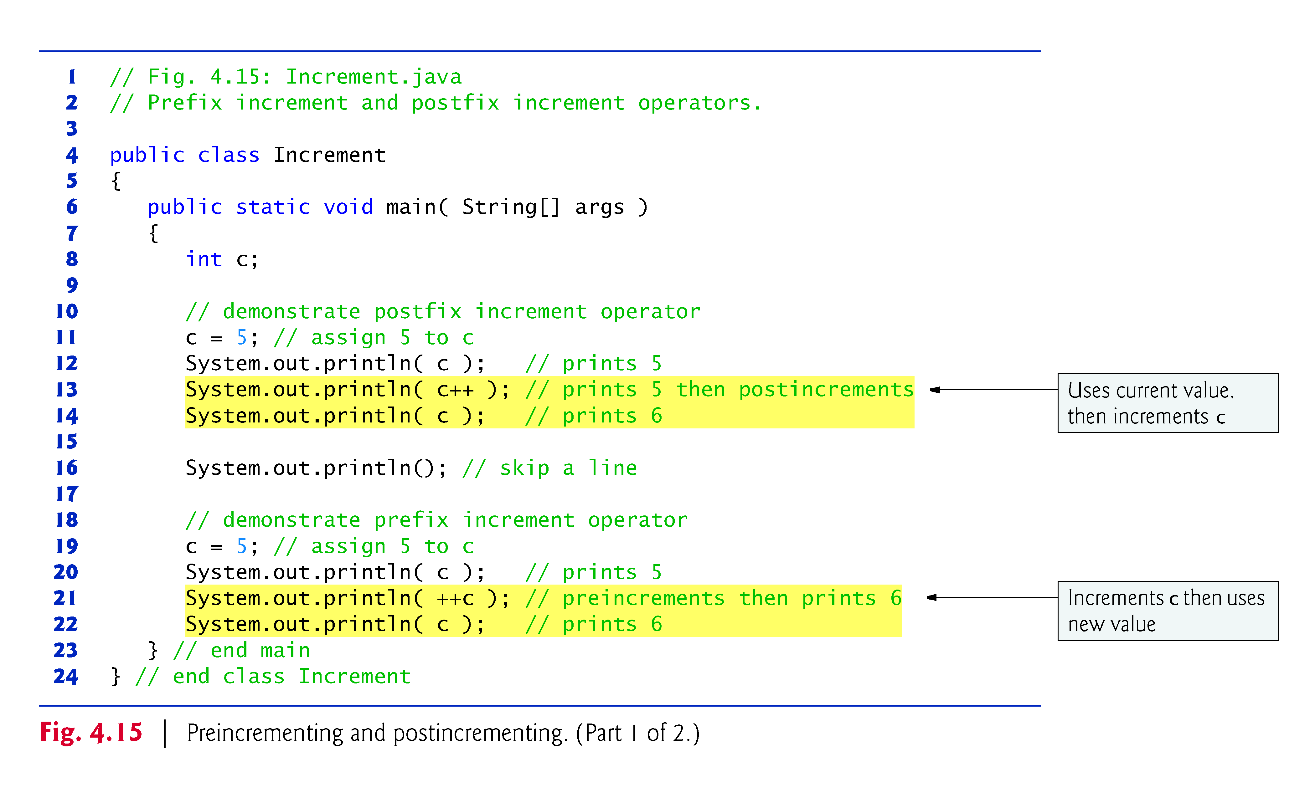

Slide 49
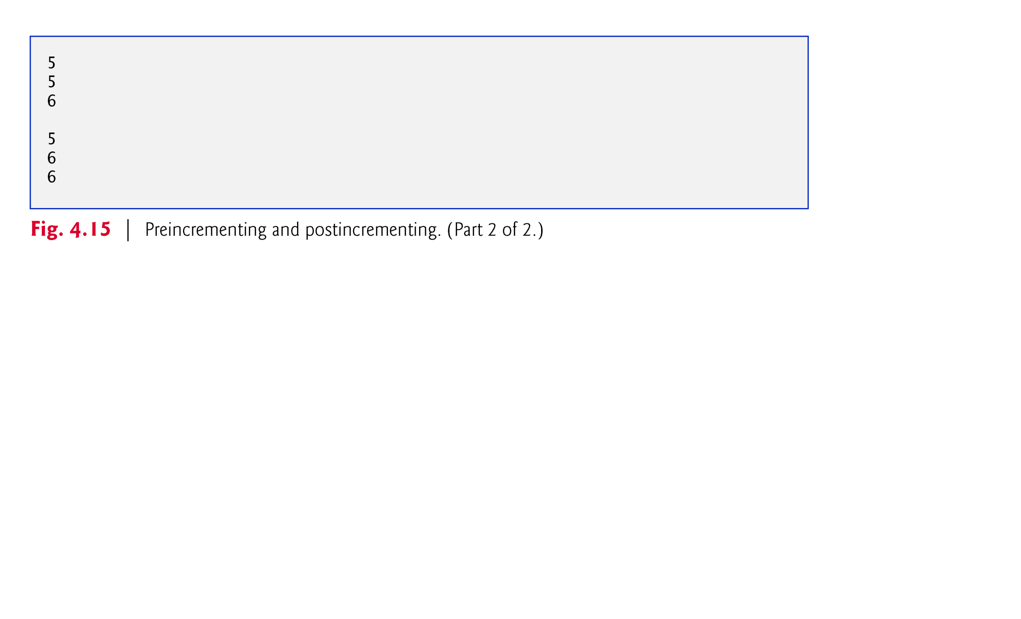

Slide 50
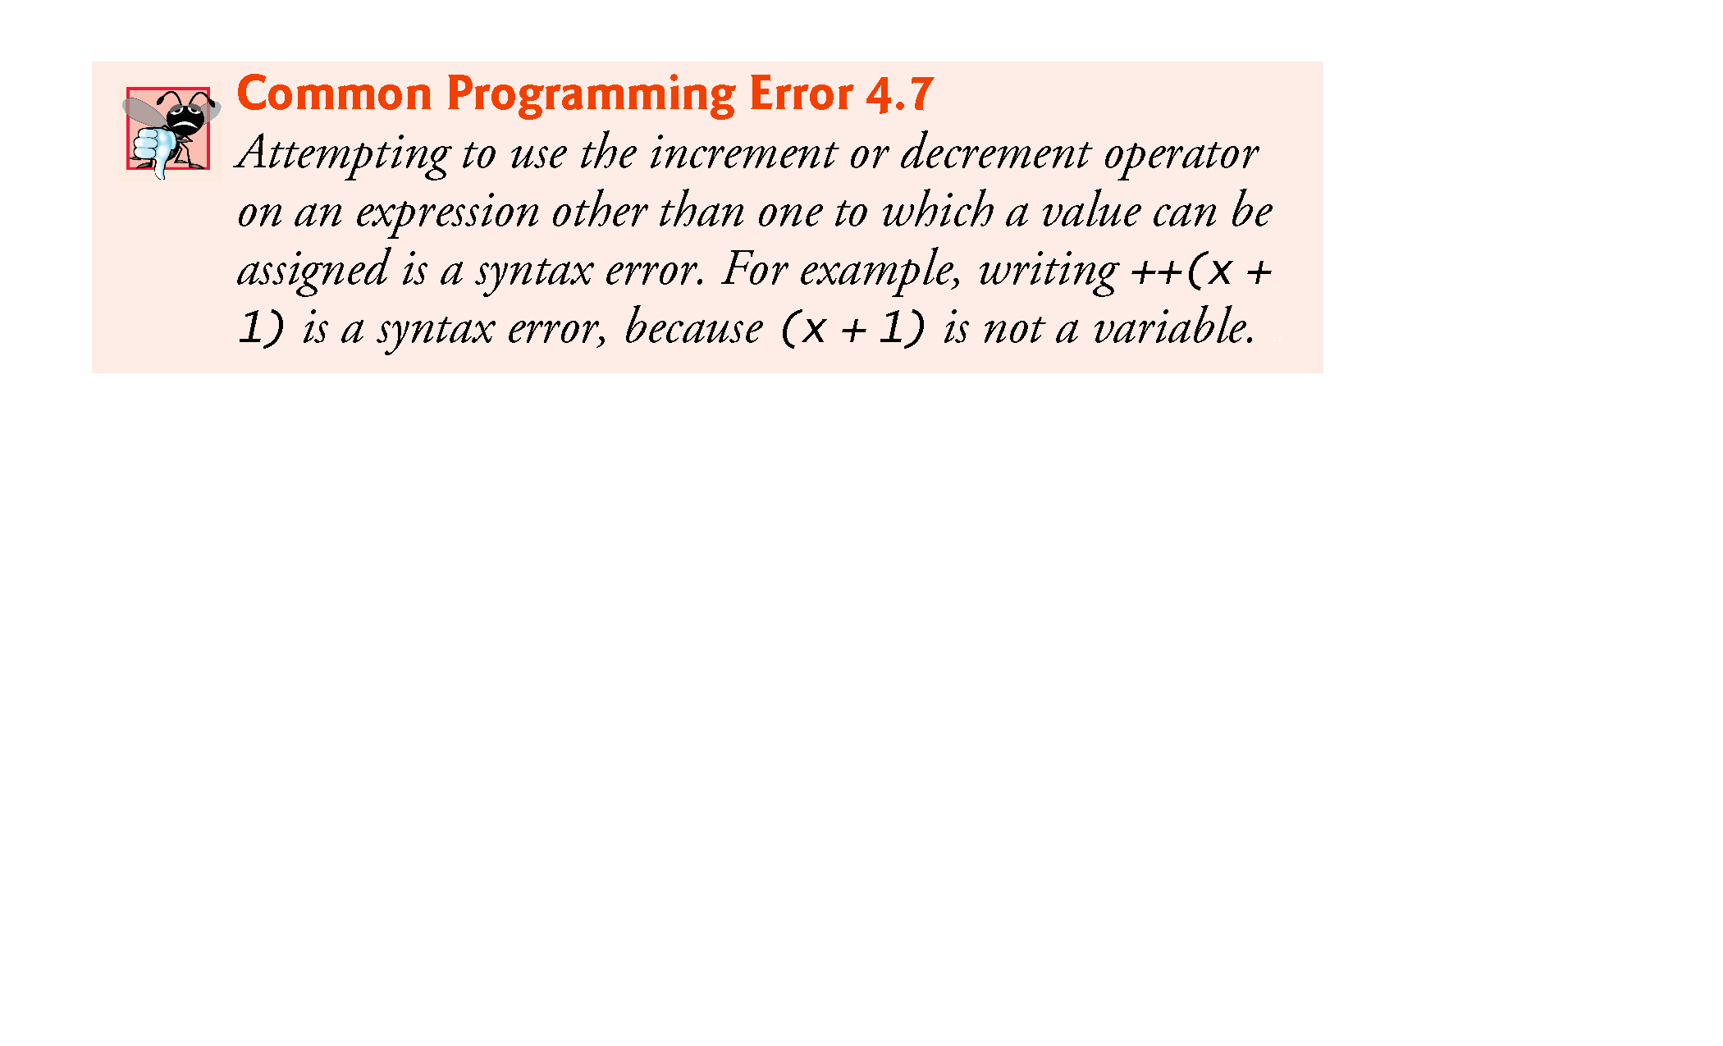

Slide 51
